Slide 1




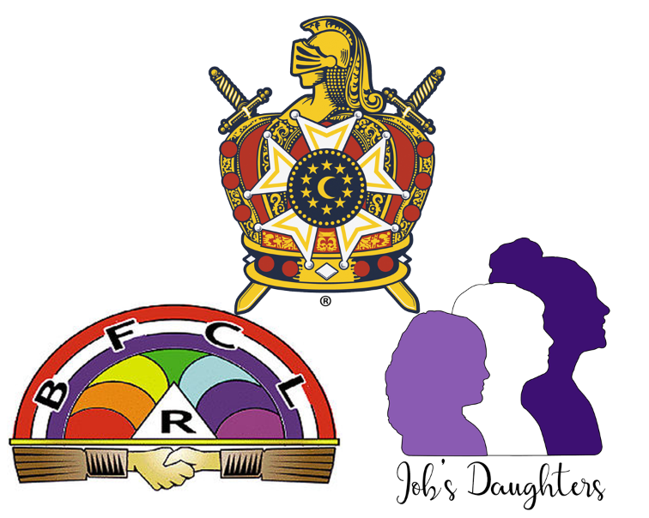




MASONIC YOUTH MEMBERSHIP AWARD FOR MASONS
Presentation - 2024

Slide 2

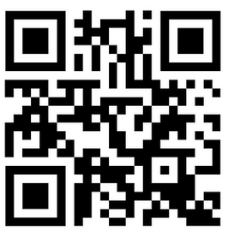
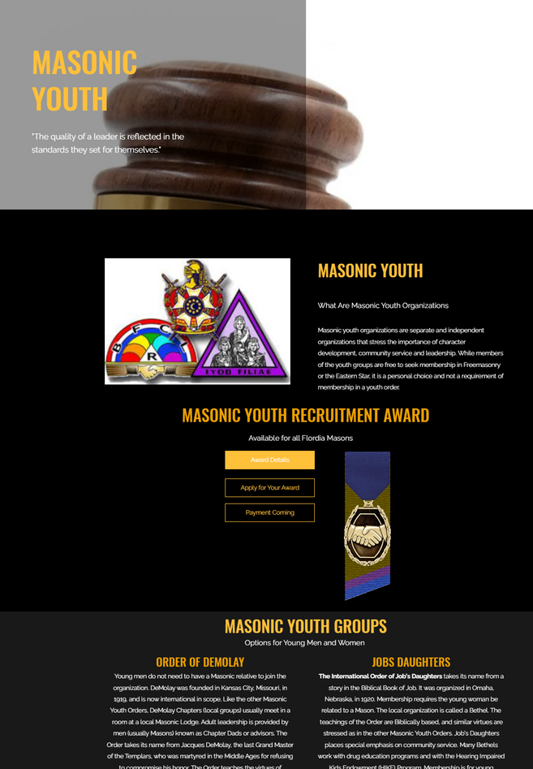
Award details, payment and application can be found here.
Masonicyouth.org

Slide 3
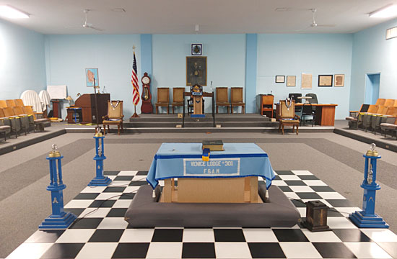
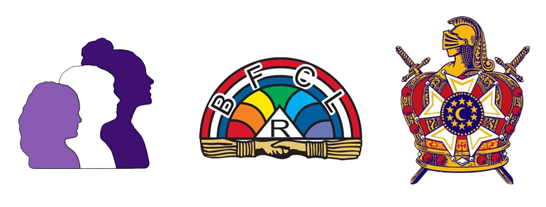
A MASON RECRUITS AND SIGNS
TWO (2) NEW MEMBERS IN A CALENDAR YEAR FOR A COMBINATION OF YOUTH ORGANIZATIONS.
Job’s
Daughters
Rainbow
for Girls
Order Of DeMolay

Slide 4
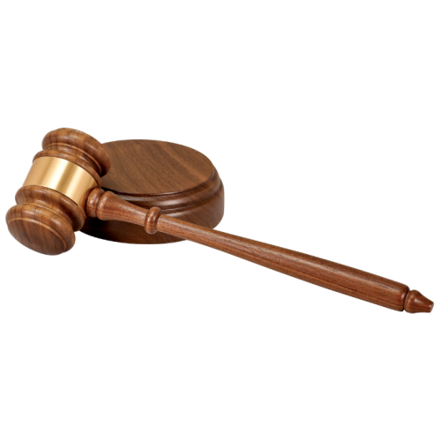








Qualifications Beyond Recruiting
Requirements
Requirements
Respective youth must complete the full initiation with DeMolay, completing the DeMolay Degree and/or the respective ritual degrees for Rainbow or Jobs.
An active registered youth must first line sign for any new members recruited in this manner. *Notthe Master Mason*
Requirements
Submit online application and award fee

Slide 5

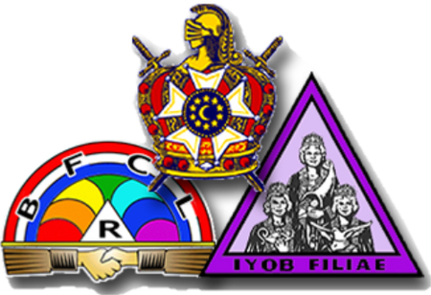




Ages of Our Masonic Youth
Requirements
Rainbow for Girls
young women ages 11 to 20
Job’s Daughters
Young women s10 to 20
DeMolay
Young men ages 12 to 21
Squires
Young men ages 9 to 12

Slide 6

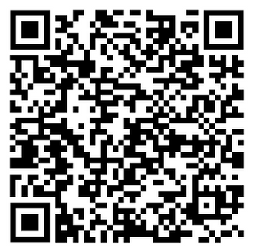
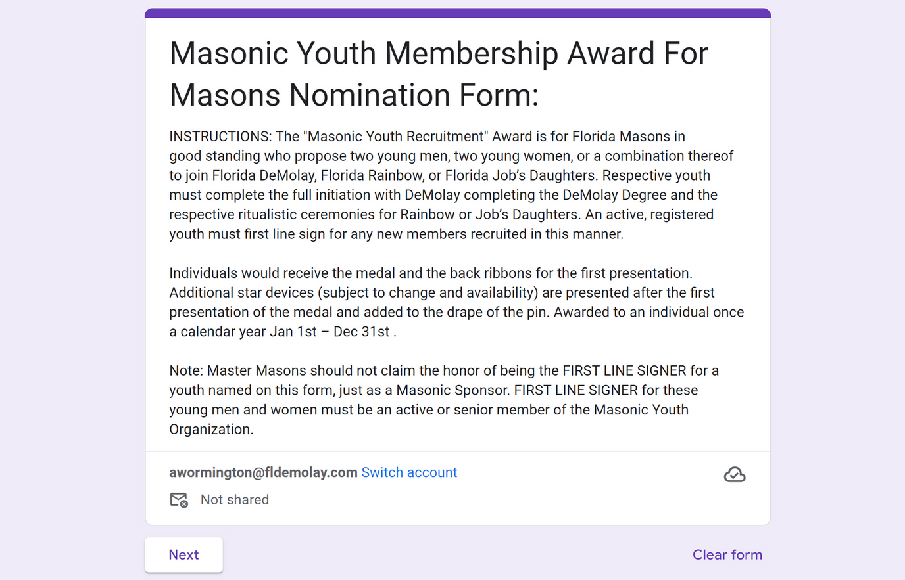
Application Form

Slide 7

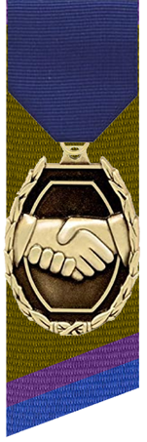


Ribbon Backing:
Color Explanation
Gold - Rainbow for Girls
Purple - Job’s Daughters
Blue - DeMolay

Slide 8



Guidelines
The award should be worn on a suit lapel and not with casual clothing or attire.
Can be worn in a Florida Masonic Blue Lodge and other Lodge activities.
Please note:
Not yet approved to be worn while attending other appended bodies at this time

Slide 9

Award details, payment and application can be found here.
Masonicyouth.org
Thank You
For Supporting our Masonic Youth!!!

